Slide 1


Luong Toan Bach
26/03/2024

Slide 2

Outline
Executive Summary
Introduction
Methodology
Results
Conclusion
Appendix

Slide 3
Executive Summary
Summary of methodologies
Data Collection
Data Wrangling
Exploratory Data Analysis with Data Visualization
Exploratory Data Analysis with SQL
Building an interactive map with Folium
Building a Dashboard with Plotly Dash
Predictive analysis
Summary of all results
Exploratory Data Analysis result
Interactive analytics demo in screenshots
Predictive analysis results

Slide 4




Introduction
Notes:
The commercial space age is coming, companies are making space travel affordable for everyone
Virgin Galactic – providing suborbital spaceflights
Rocket Lab – small satellite provider
Blue Origin – manufactures sub-orbital reusable rockets
Most successful is SpaceX

Slide 5
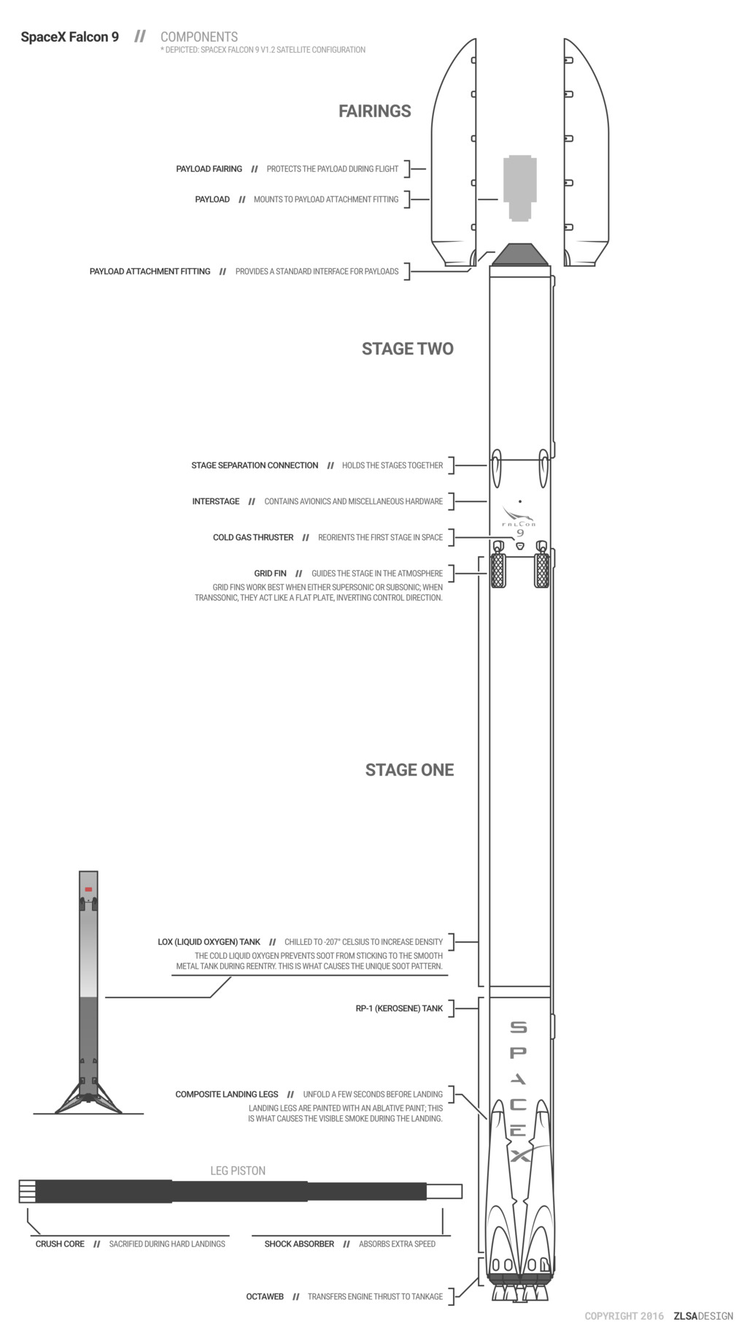
Introduction
SpaceX’s Falcon 9 rocket launches are relatively in expensive (62,000 $ vs. 165,000 $ with other providers).
The savings is coming from reusing the first stage but it have chance to fail.
Therefore, if we can determine if the first stage will land, we can determine the cost of a launch.
Notes:
One reason SpaceX can do this is the rocket launches are relatively inexpensive
SpaceX’s Falcon 9 rocket launches with a cost of 62 million dollars.
Other providers cost upwards of 165 million dollars.
Much of the savings is because SpaceX can reuse the first stage.
Therefore, if we can determine if the first stage will land, we can determine the cost of a launch.

Slide 6

Section 1

Slide 7
Methodology
Data collection methodology:
Using SpaceX Rest API
Using Web Scrapping from Wikipedia
Perform data wrangling
Filtering the data
Dealing with missing values
Encode data
Perform exploratory data analysis (EDA) using visualization and SQL
Perform interactive visual analytics using Folium and Plotly Dash
Perform predictive analysis using classification models
Building, tuning and evaluation of classification models to ensure the best results

Slide 8
Data Collection
Data collection process involved a combination of API requests from SpaceX REST API and Web Scraping data from a table in SpaceX’s Wikipedia entry.
Data contains 15 columns:
BoosterVersion
PayloadMass
LaunchSite
Outcome
Flights
GridFins
Reused
Legs
LandingPad
Block
ReusedCount
Serial
Longitude
Latitude

Slide 9
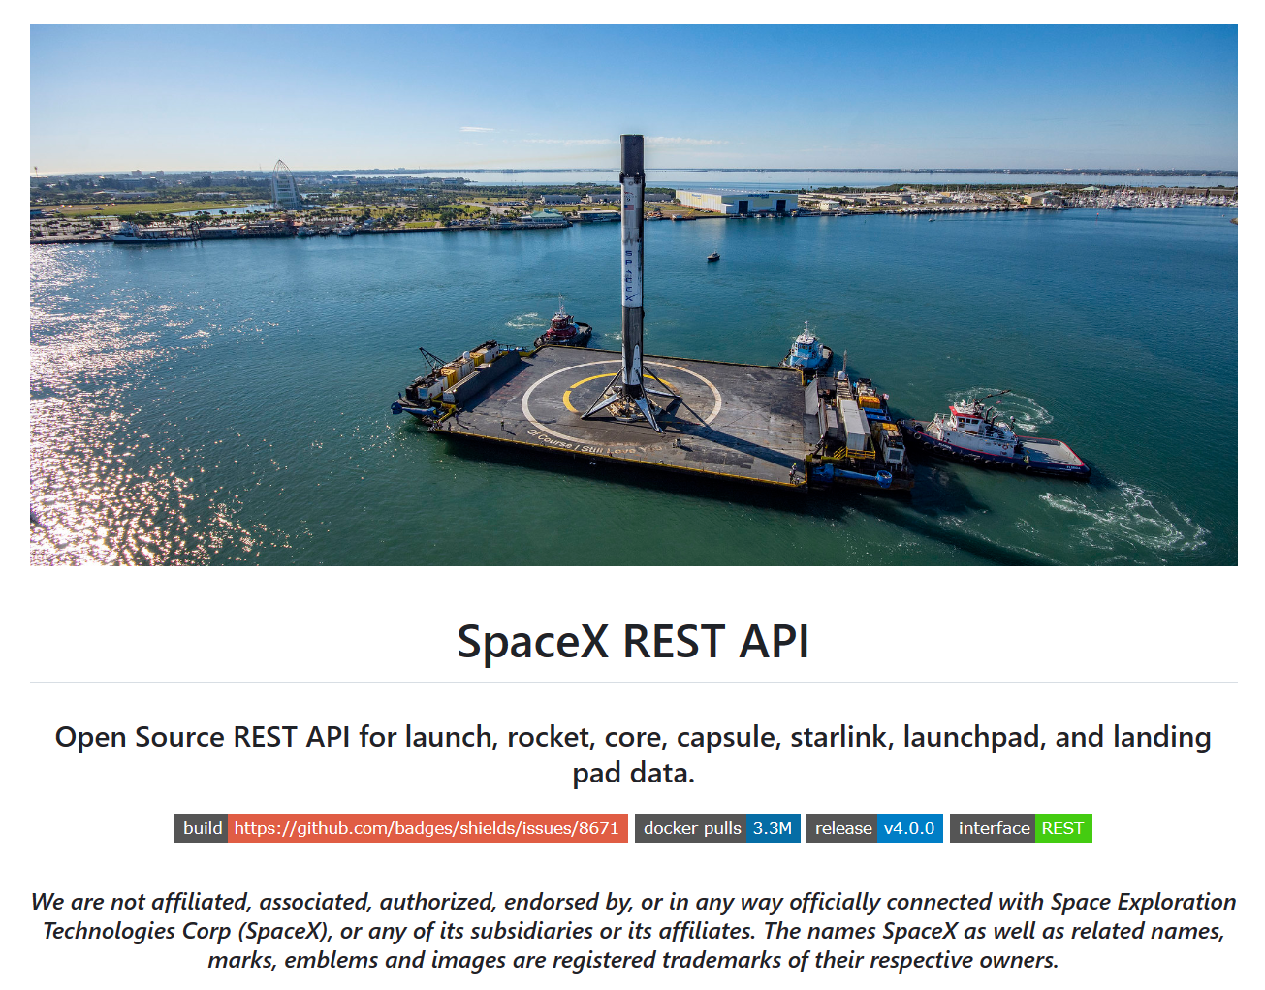
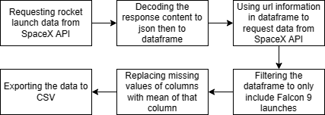
Data Collection – SpaceX API
https://github.com/LTBach/Applied-Data-Science-Capstone/blob/main/src/data_collection_api.ipynb
https://github.com/r-spacex/SpaceX-API

Slide 10
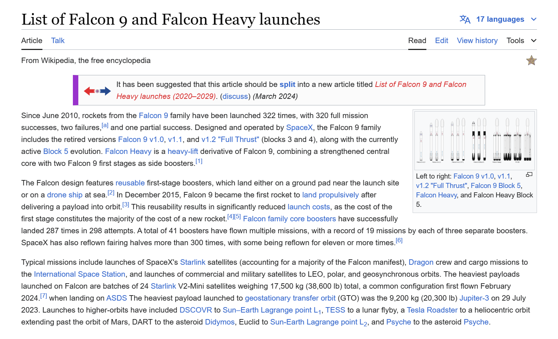
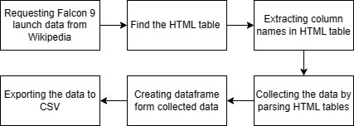
Data Collection - Scraping
https://github.com/LTBach/Applied-Data-Science-Capstone/blob/main/src/data_collection_web_scrapping.ipynb
https://en.wikipedia.org/wiki/List_of_Falcon_9_and_Falcon_Heavy_launches

Slide 11
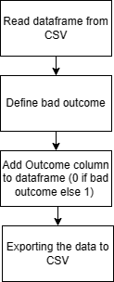
Data Wrangling
In the data set, there are several different cases where the booster did not land successfully.
We will convert those outcomes into column “Outcome” where:
“1” means the booster successfully landed
“0” otherwise
https://github.com/LTBach/Applied-Data-Science-Capstone/blob/main/src/data_wrangling.ipynb

Slide 12
EDA with Data Visualization
Plots in this part includes:
Visualize the relationship between two variables:
Scatter (Flight Number, Payload Mass)
Scatter (Flight Number, Launch Site)
Scatter (Payload, Launch Site)
Bar (Orbit Type, Success Rate)
Scatter (Flight Number, Orbit Type)
Scatter (Payload Mass, Orbit Type)
Trend:
Line (Year, Success Rate)

Slide 13
EDA with SQL
Queries include:
Finding all launch site name
Finding launch site names begin with ‘CCA’
Finding total payload mass
Finding average payload mass by F9 v1.1
Finding first successful ground landing date
Finding successful drone ship landing with payload between 4000 and 6000
Finding total number of successful and failure mission outcomes
Finding booster carried maximum payload
Finding 2015 launch records
Finding rank success count between 2010 and 2017

Slide 14
Build an Interactive Map with Folium
Interactive Map have 3 main features:
Display all launch site’s location as Marker
For each launch site it have colour-labeled markers for identify the number of success and failed launch.
It also display the distance from the launch site KSC LC-39A to its proximities in order to predict any risk of fail launch.
https://github.com/LTBach/Applied-Data-Science-Capstone/blob/main/src/interactive_visual_analytics_with_Folium.ipynb

Slide 15
Build a Dashboard with Plotly Dash
Dashboard have 3 main features:
Display launch success for all sites as pie chart.
Display the launch success ratio for each launch site as pie chart.
Display the result of the launch according to payload mass range.
https://github.com/LTBach/Applied-Data-Science-Capstone/blob/main/src/dash_app.ipynb

Slide 16
Predictive Analysis (Classification)
Algorithms are envolve:
Logistic Regression
Support Vector Machine
Decision Tree
K-Nearest Neighbors
Each algorithm is participate in 3-step process:
Train on train dataset (Train)
Test on test dataset (Evaluate)
Examine on confusion matrix
To keep fairness, we will test these algorithms on 3 objective functions:
Jaccard_Score
F1_Score
Accuracy

Slide 17
Results
Exploratory data analysis results
Interactive analytics demo in screenshots
Predictive analysis results

Slide 18

Section 2

Slide 19
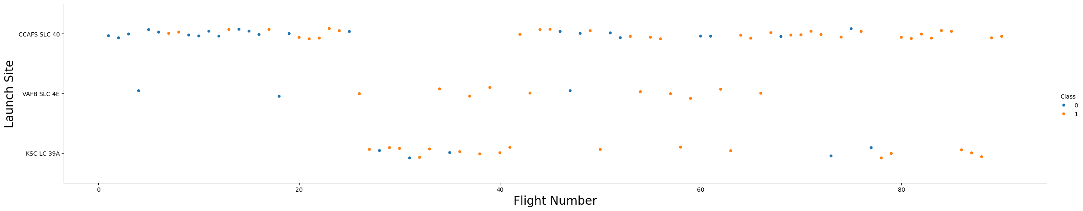
Flight Number vs. Launch Site
Explanation:
The earliest flights all failed while the latest flights all succeeded.
The CCAFS SLC 40 launch site has about a half of all launches.
VAFB SLC 4E and KSC LC 38A have higher success rates.
It can be assumed that each new launch has a higher rate of success

Slide 20
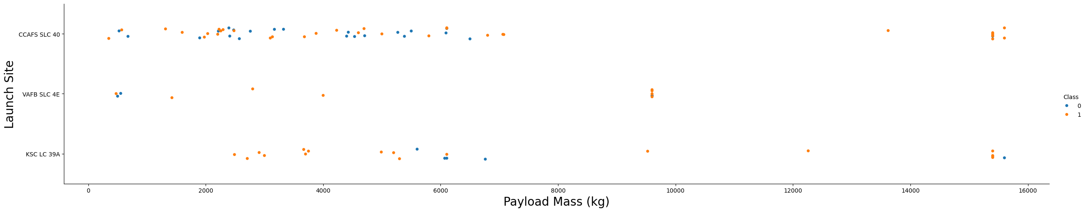
Payload vs. Launch Site
Explanation:
For every launch site the higher the payload mass, the higher the success rate.
Most of the launches with payload mass over 7000 kg were successful.
KSC LC 39A has a 100% success rate for payload mass under 5500 kg too.

Slide 21
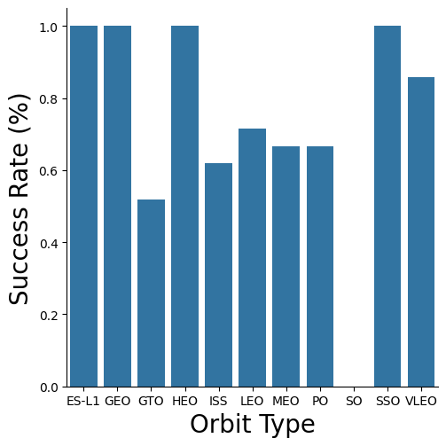
Success Rate vs. Orbit Type
Explanation:
Orbits with 100% success rate
ES-L1, GEO, HEO, SSO
Orbits with 0% success rate:
SO
Orbits with success rate between 50% and 85%:
GTO, ISS, LEO, MEO, PO

Slide 22
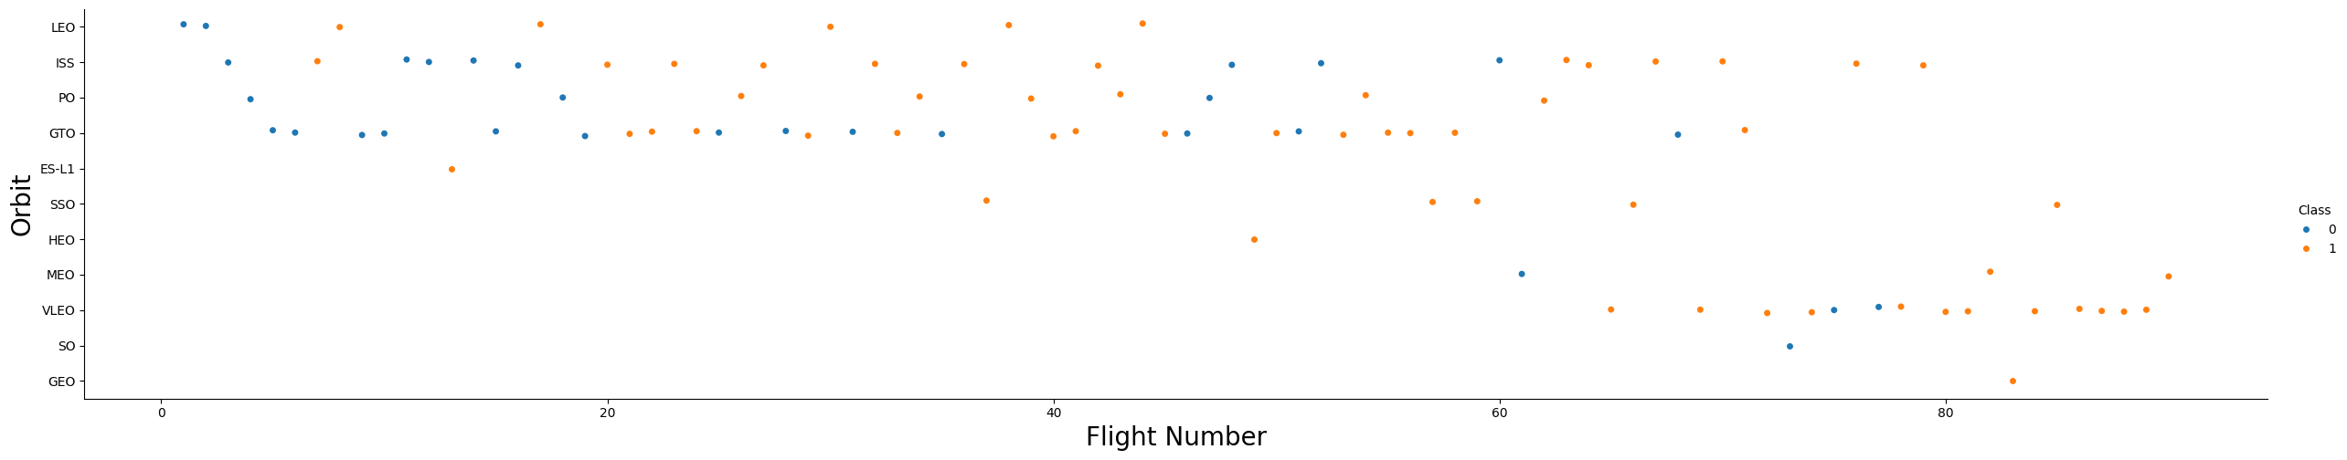
Flight Number vs. Orbit Type
Explanation:
In the LEO orbit the Success appears related to the number of flights
On the other hand, there seems to be no relationship between flight number when in GTO orbit.

Slide 23
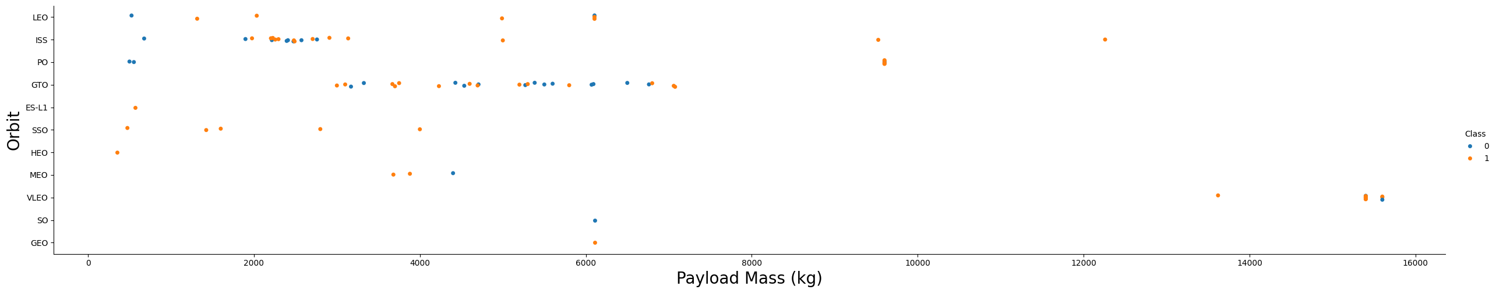
Payload vs. Orbit Type
Explanation:
Heavy payloads have a negative influence on GTO orbits and positive on GTO and Polar LEO (ISS) orbits.

Slide 24
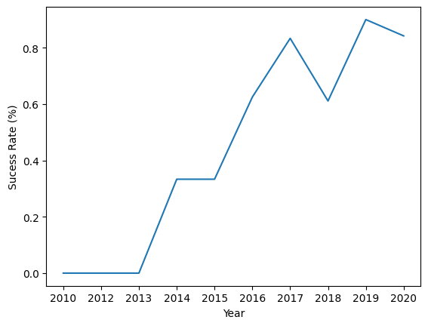
Launch Success Yearly Trend
Explanation:
The success rate since 2013 kept increasing till 2020.

Slide 25
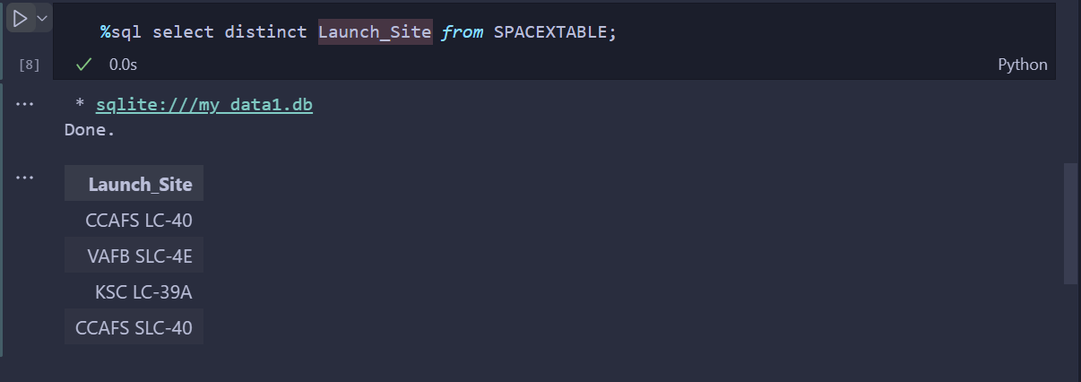
All Launch Site Names
Explanation:
Displaying the names of the unique launch sites in the space mission.

Slide 26
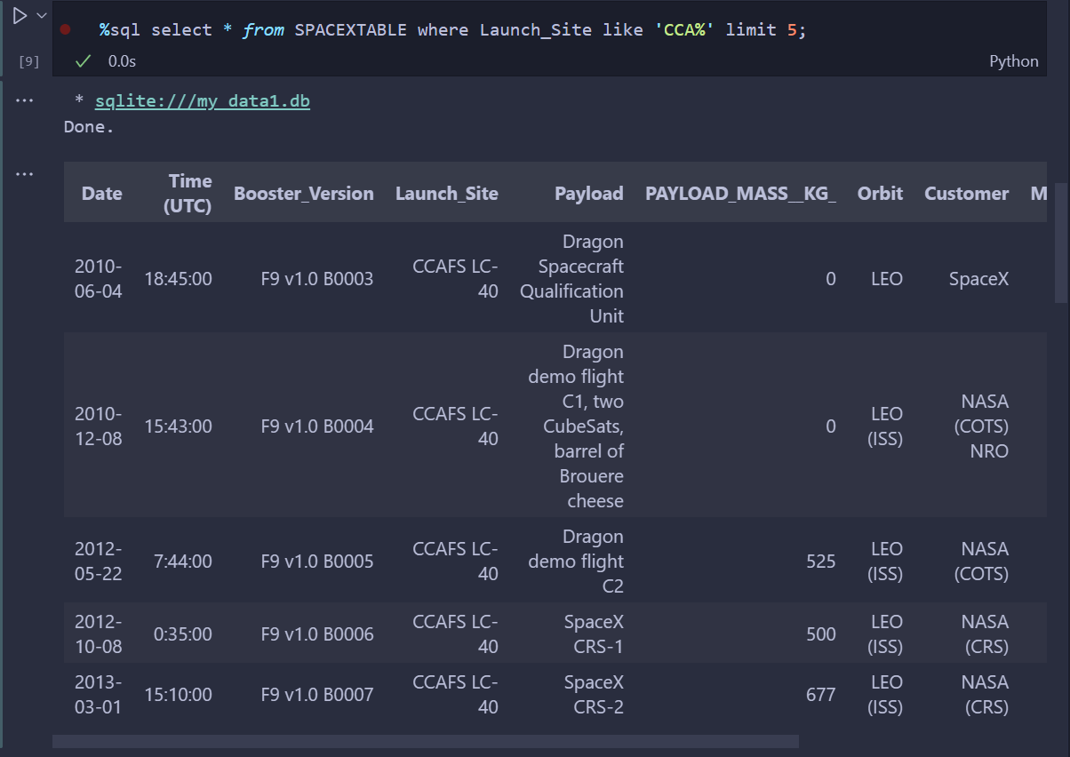
Launch Site Names Begin with 'CCA'
Explanation:
Displaying 5 records where launch sites begin with the string ‘CCA’.

Slide 27
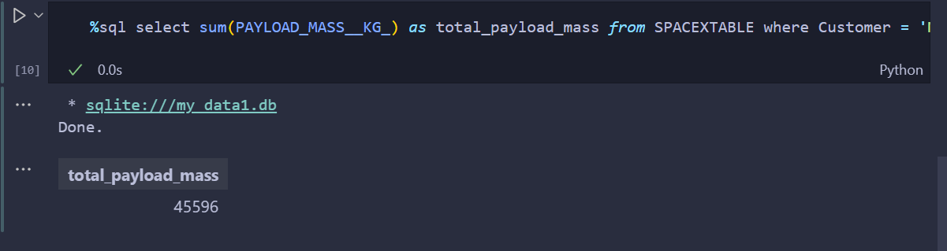
Total Payload Mass
Explanation:
Displaying the total payload mass carried by boosters launched by NASA (CRS).

Slide 28
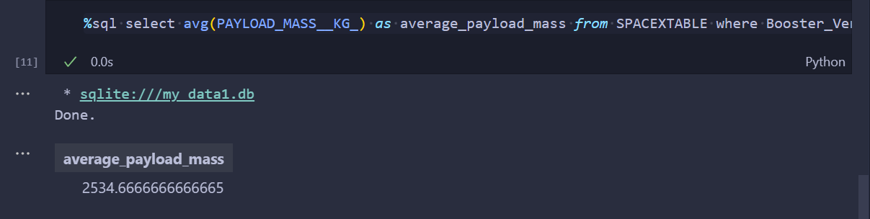
Average Payload Mass by F9 v1.1
Explanation:
Displaying average payload mass carried by booster version F9 v1.1.

Slide 29
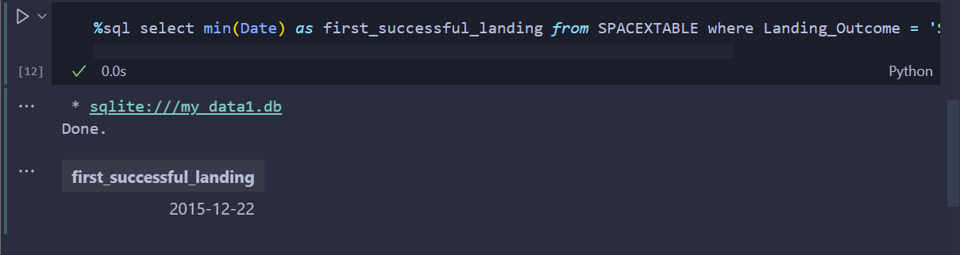
First Successful Ground Landing Date
Explanation:
Listing the date when the grist successful landing outcome in ground pad was achieved.

Slide 30
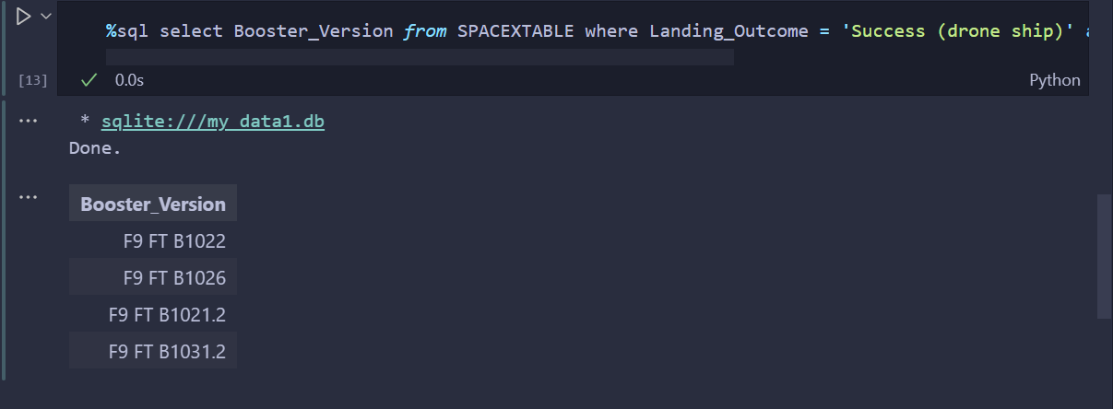
Successful Drone Ship Landing with Payload between 4000 and 6000
Explantation:
Listing the names of the boosters which have success in drone ship and have payload mass greater than 4000 but less than 6000

Slide 31
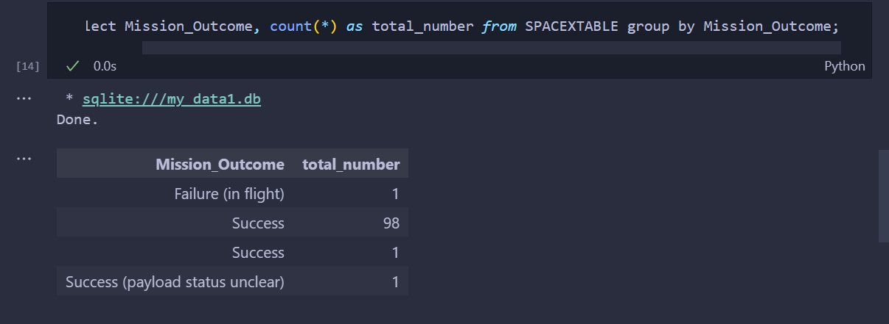
Total Number of Successful and Failure Mission Outcomes
Explanation:
Listing the total number of successful and failure mission outcomes.

Slide 32
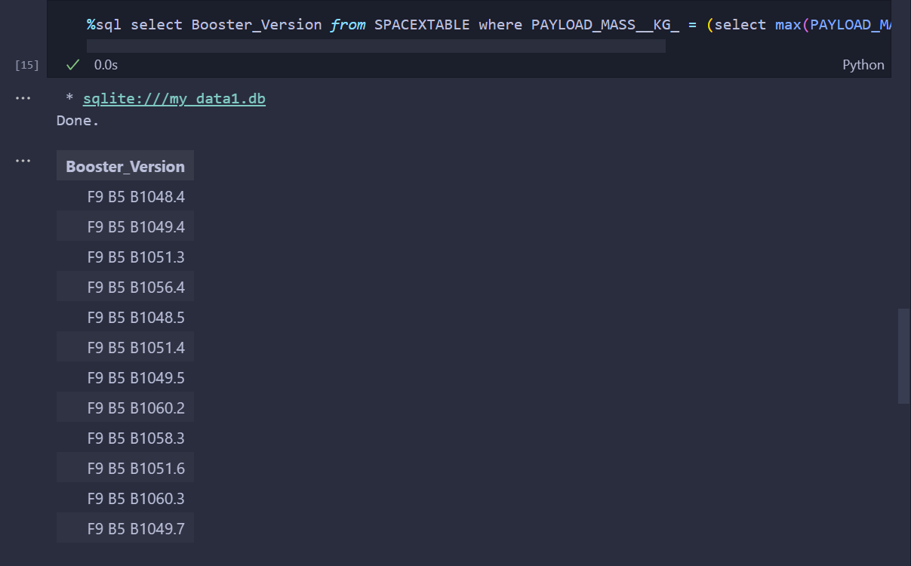
Boosters Carried Maximum Payload
Explanation:
Listing the names of the booster versions which have carried the maximum payload mass

Slide 33
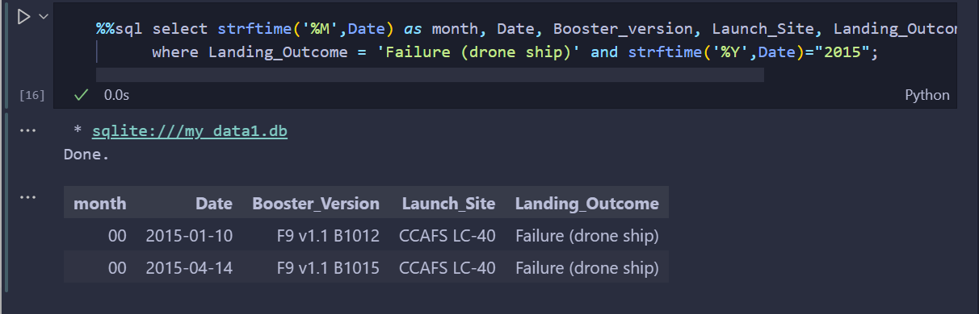
2015 Launch Records
Explanation:
Listings the failed landing outcomes in drone ship, their booster versions and launch site names for the months in year 2015.

Slide 34
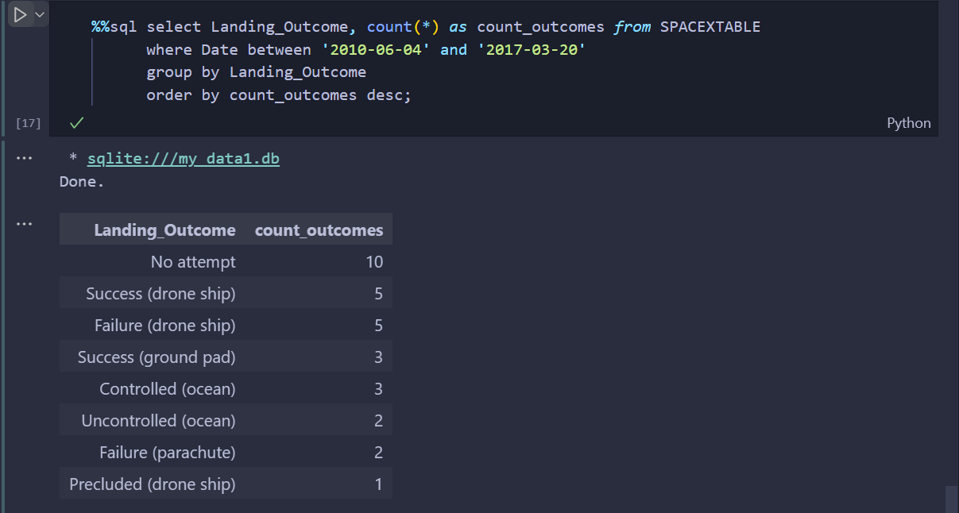
Rank Landing Outcomes Between 2010-06-04 and 2017-03-20
Explanation:
Ranking the count of landing outcomes between the date 2010-06-04 and 2017-03-20 in descending order.

Slide 35

Section 3

Slide 36
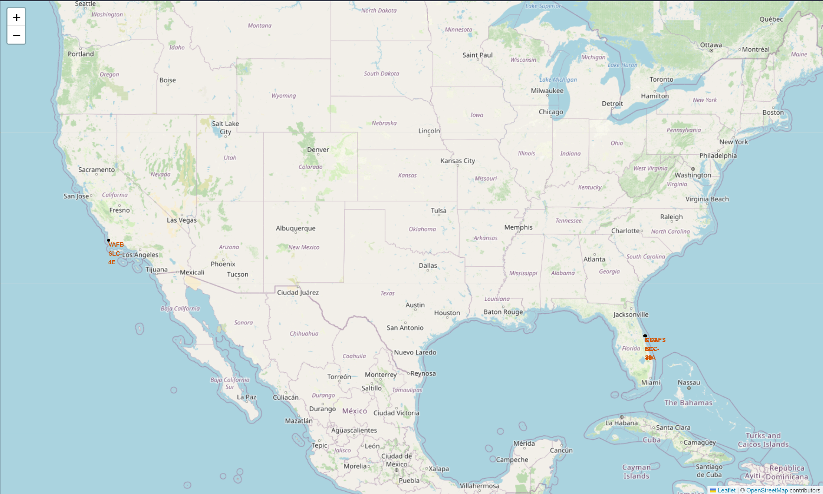
All launch sites’s location
Explanation:
Most of Launch sites are in proximity to the Equator line. The inertia of Earth will help the spacecraft to stay in orbit.
All launch sites are in very close proximity to the coast. In order to minimize the risk of having any debris dropping or exploding near people.

Slide 37
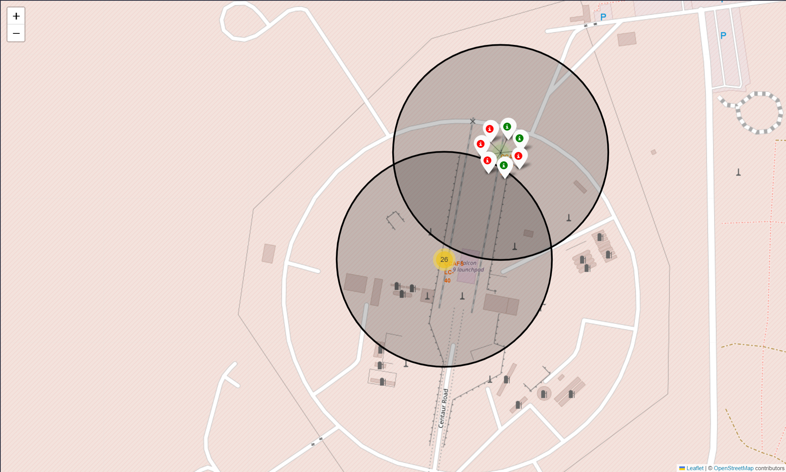
Colour-labeled launch records
Explanation:
Green Marker = Successful Launch
Red Marker = Fail Launch
Launch Site KSC LC-39A has a very high Success Rate.

Slide 38
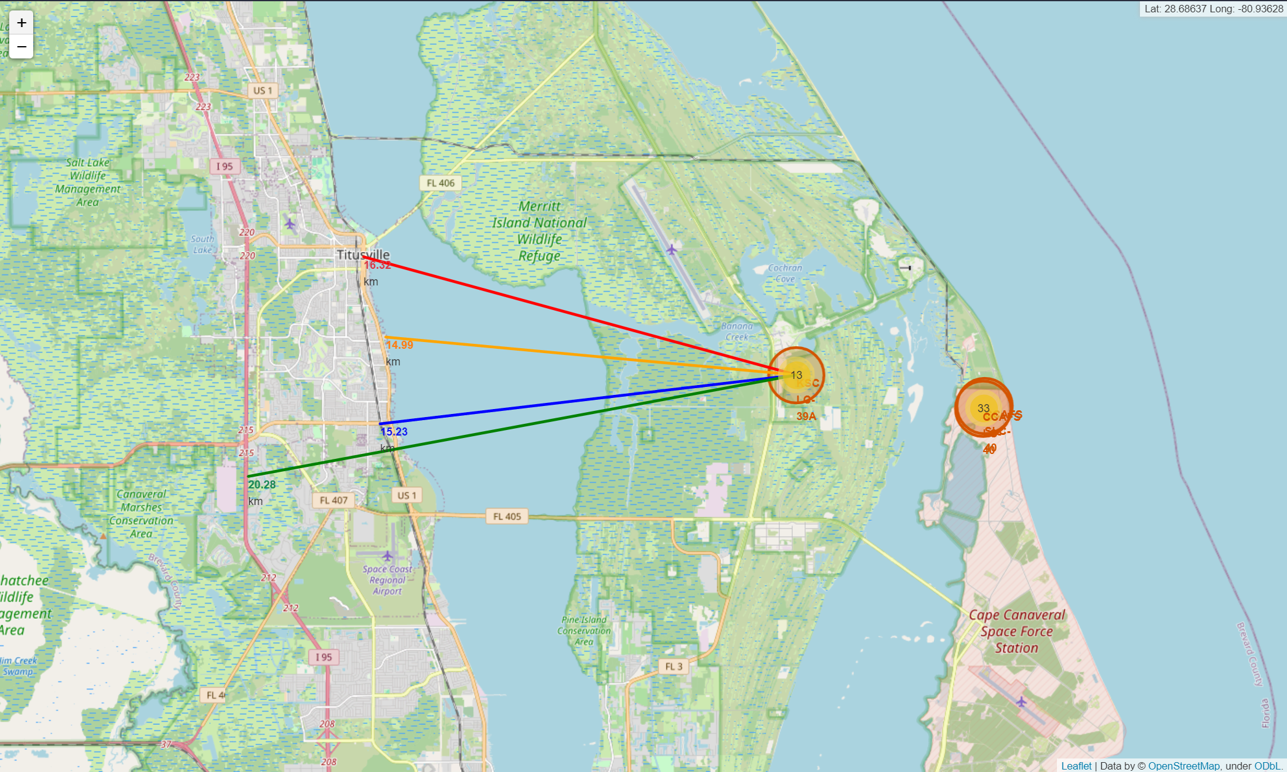
Distance from KSC LC-39A to its neighborhood
Explanation:
KSC LC-29A is relative close to:
Railway (15.23 km)
Highway (20.28 km)
Coastline (14.99 km)
Titusville (16.32 km)
Failed rocket could be potentially dangerous for neighborhood.

Slide 39

Section 4

Slide 40
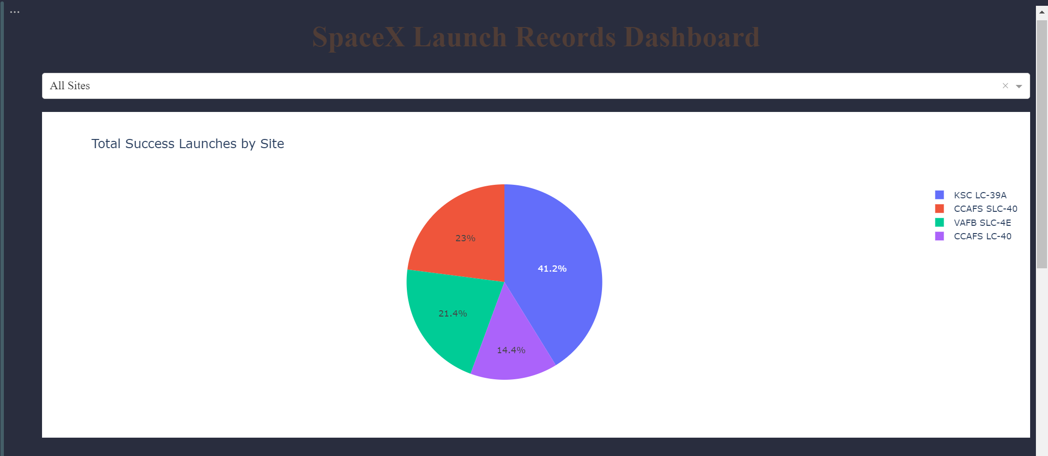
Launch Success Count For All Sites
Explanation:
The chart clearly shows that from all the sites, KSC LC-39A has the most successful launchs.

Slide 41
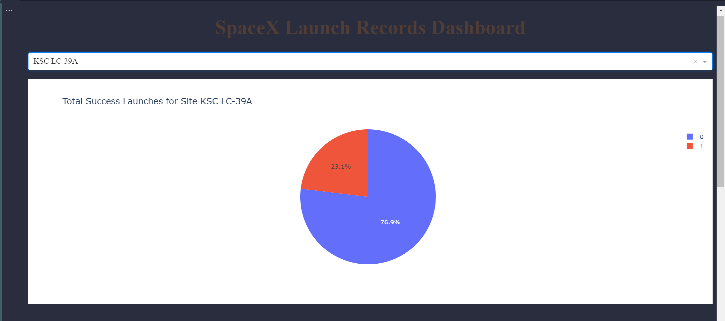
Highest Success Rate Launch Site
Explanation:
KSC LC-39A has the highest launch success rate (76.9%) with 10 successful and only 3 failed landings.

Slide 42
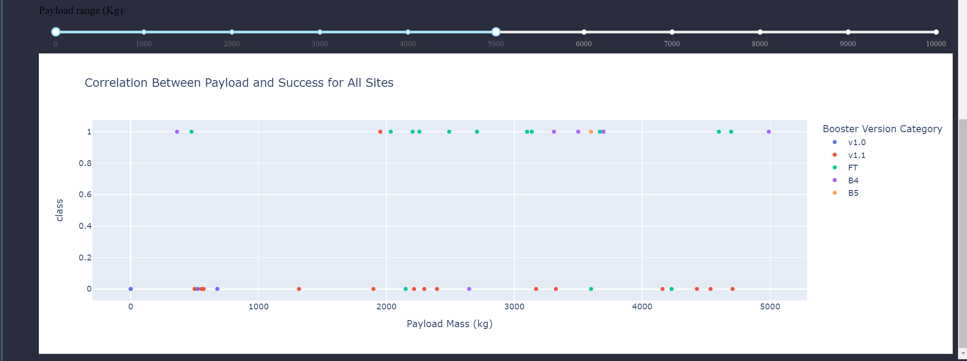
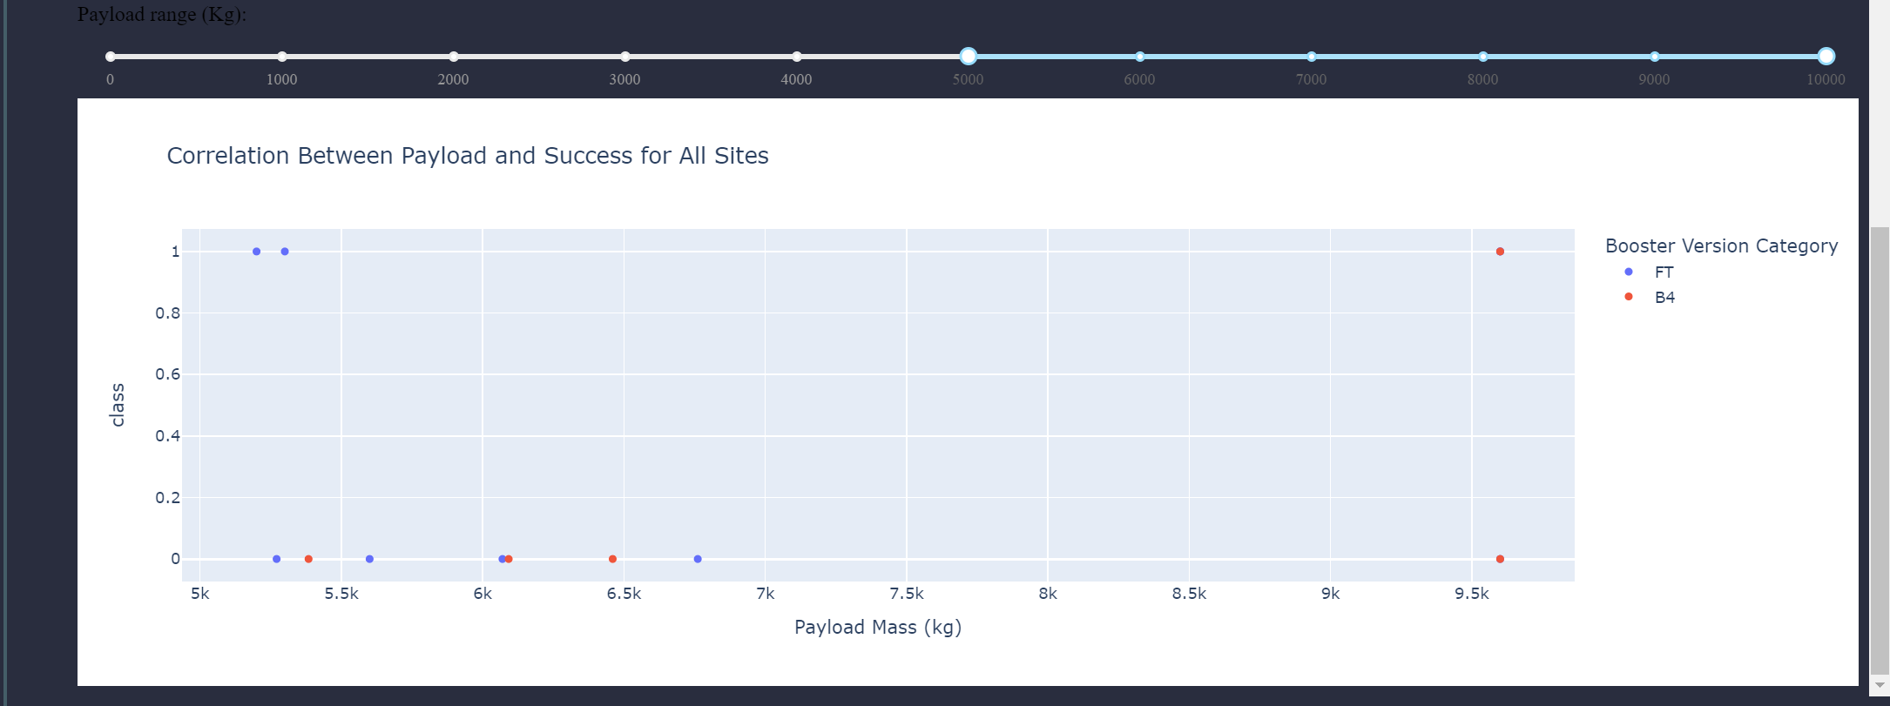
Payload Mass vs. Launch Outcome
Explanation:
The charts show that payloads between 2000 and 55000 kg have the highest success rate.

Slide 43

Section 5

Slide 44
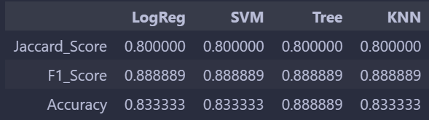
Classification Accuracy
Explanation:
Based on the score of each algorithms on test set we can see that:
All algorithms have same score in F1_Score and Jaccard_Score
The best algorithm is Decision Tree model.

Slide 45
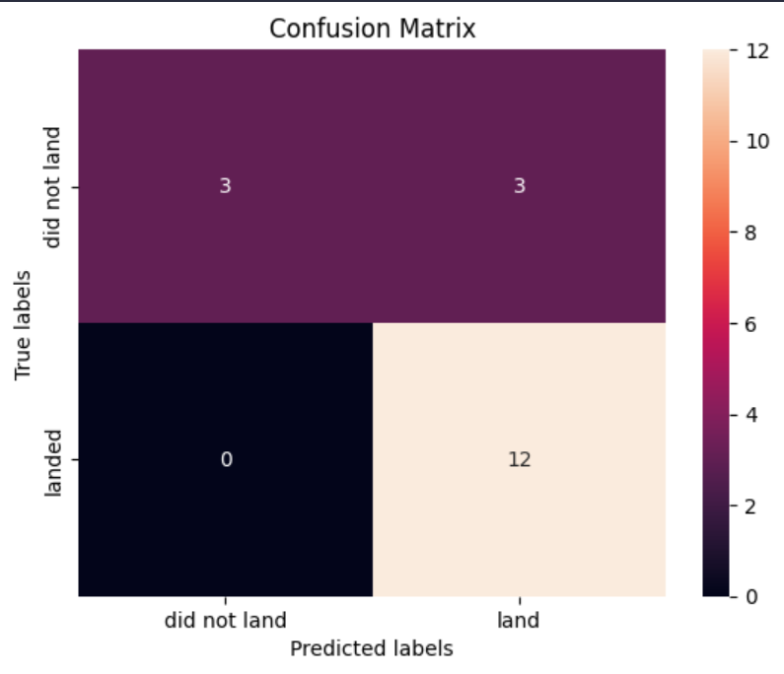
Confusion Matrix
Explanation:
Major error in classification belong to type II error (False Negative)

Slide 46
Conclusions
Decision Tree Model is the best algorithm for this dataset.
Launches with a low payload mass show better results than launches with a larger payload mass.
The higher the payload mass, the higher the success rate.
Most of launch sites are in proximity to the Equator line and all the sites are in very close proximity to the coast.
The success rate of launches increases over the years.
KSC LC-39A has the highest success rate of the launches from all the sites.
Orbits ES-L!, GEO, HEO and SSO have 100% success rate.

Slide 47
Appendix
Special Thanks to:
Instructors
Coursera
IBM

Slide 48


